Slide 1
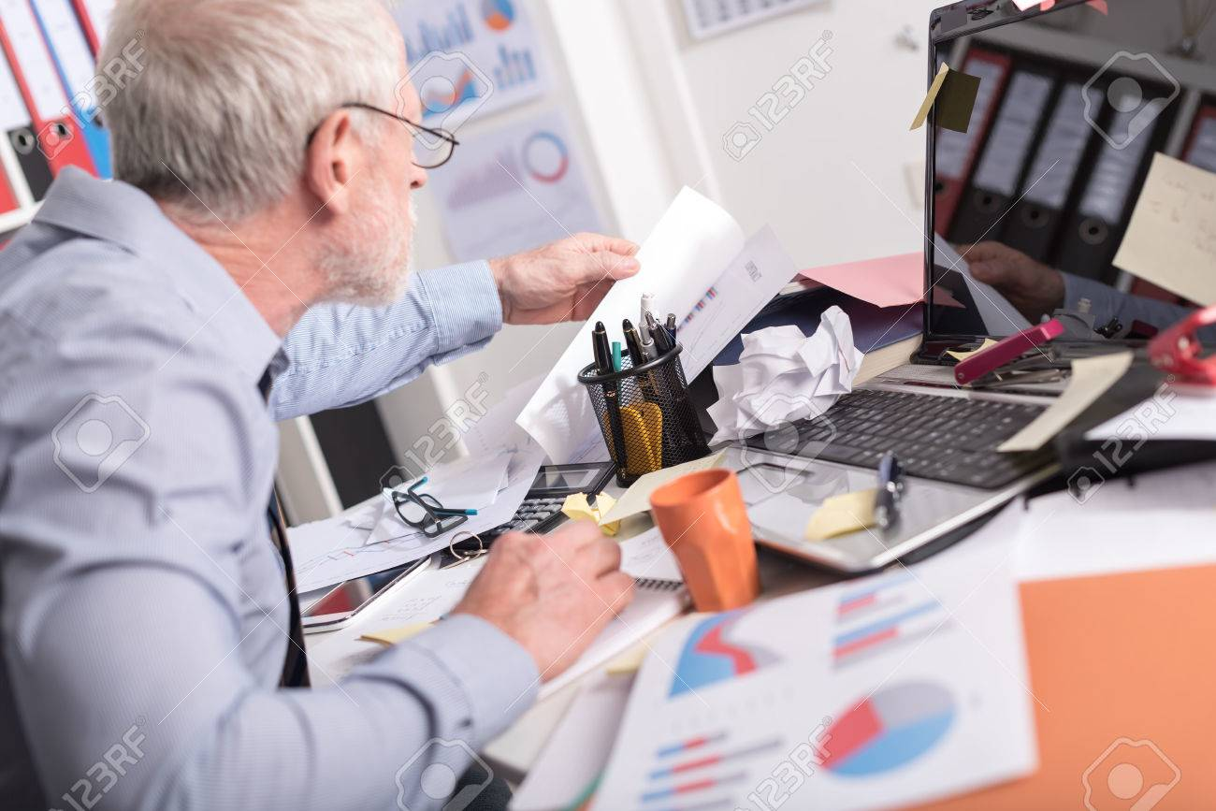
“It’s getting so hard for me to keep track of time, maybe I should just retire…”
Pains
Worsening eyesight and motor function
Can’t keep up with modern pace of new apps and technology
Physically disorganized
Gains
Easy to read/scalable font size
Independent of work software, can add personal tasks/events
Web access allows tasks to be viewed from any device
Name: Bill Farsfield
Occupation: CFO
Age: 64
Enjoys travelling, classical music, red wine, and motorhoming with his wife

Slide 2

“Between football practice, student council, my job, and family life, I can never seem to remember everything I need to complete.”
Name: Cameron Farhinger
Occuptation: Student
Age: 17
Enjoys football, going to concerts, and hanging out with his friends.
Pains
Two-a-day football practice makes him tired and forgetful
Prone to losing things
Gains
Better grades
Tasks are always accessible online

Slide 3

“Sometimes I work out so hard I’ll forget to eat. I need to remind myself to relax and take a break sometimes.”
Pains
Keeping up with all his workout routines and steps
Managing travel plans and arrangements
Remembering to eat his 6 meals a day
Gains
More effective exercise regimen
Better diet
Catching his flights
Name: Jason Schobert
Occupation: Professional skier
Age: 34
Enjoys working out, hiking, and making YouTube videos.

